Slide 1




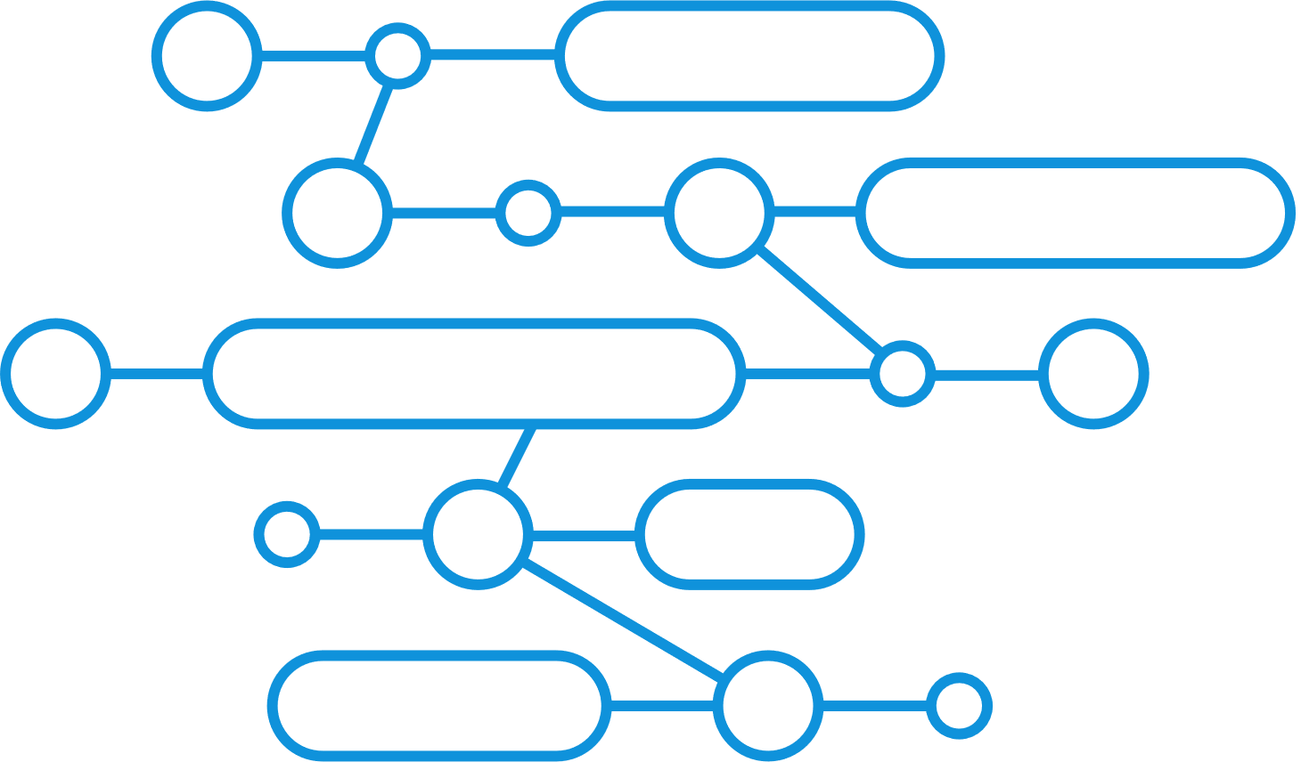
Bestlink College of the Philippines-Bulacan Inc.
HR TECHNOLOGY AND ANALYTICS SYSTEM – BCP MAIN CAMPUS NOVALICHES
Human Resource System

Slide 2
INTRODUCTION

Slide 3

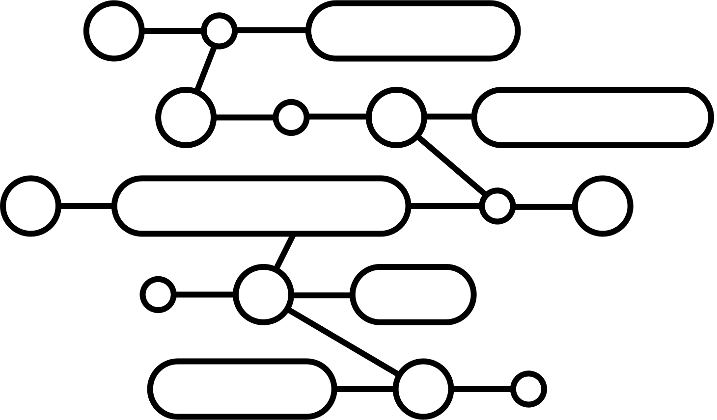
What is the History of HR Technology and analytics System?

Slide 4

INTRODUCTION
HR technology has come a long way since the late 19th century, moving from simple record-keeping to advanced AI-powered systems. Important changes include the use of mainframe computers in the mid-1900s, standalone HR software in the 1980s and 1990s, and integrated HR systems in the 2000s. More recently, cloud computing, AI, and big data have helped make HR more strategic by using predictive analytics.

Slide 5
CLIENT BACKGOUND
Bestlink College of the Philippines is currently dealing with challenges in their manual HR operations and is planning to use HR technology to make things more efficient, better organize their data, and improve recruitment and workforce management. Their new system will use tools like Microsoft Excel to manage employee information, provide dashboards for easy data access, and have a user-friendly design. The project’s goal is to improve HR processes and
decision-making, with the BSIS students focusing
on creating a system that meets the client's needs
and is built for the future.

Slide 6
Client Problem
Our client is having trouble managing and organizing files using their current manual system. A possible solution is to create a clear filing system with categories and subcategories. Using consistent names for files would make it easier to find information quickly. Regular checks and maintenance of the filing system are also important to prevent losing files and to keep the organization running smoothly.
Absence of a system.
Dependence on manual operations.
Difficulty in maintaining and organizing various files.
Struggle to quickly locate necessary information.
Requirement for meticulous file storage to prevent loss.

Slide 7
Solution
1.Absence of a system:
The implementation of a modern HR system addresses the absence of an efficient system, replacing manual or Excel-based methods with a digital, automated solution.
2. Dependence on manual operations:
Automating HR processes such as employee data management, payroll, and contracts reduces the need for manual data entry, improving overall efficiency and accuracy.
3. Difficulty in maintaining and organizing various files:
A centralized database within the HR system ensures that all employee records and HR-related files are stored and organized in one secure location, making it easier to manage.
4. Struggle to quickly locate necessary information:
The HR system allows for quick and easy access to employee information, as well as generating reports with just a few clicks, significantly reducing time spent searching for data.
5. Requirement for meticulous file storage to prevent loss:
A HR system provides data backups and advanced security features to prevent data loss, ensuring that important information is securely stored and easily retrievable.

Slide 8


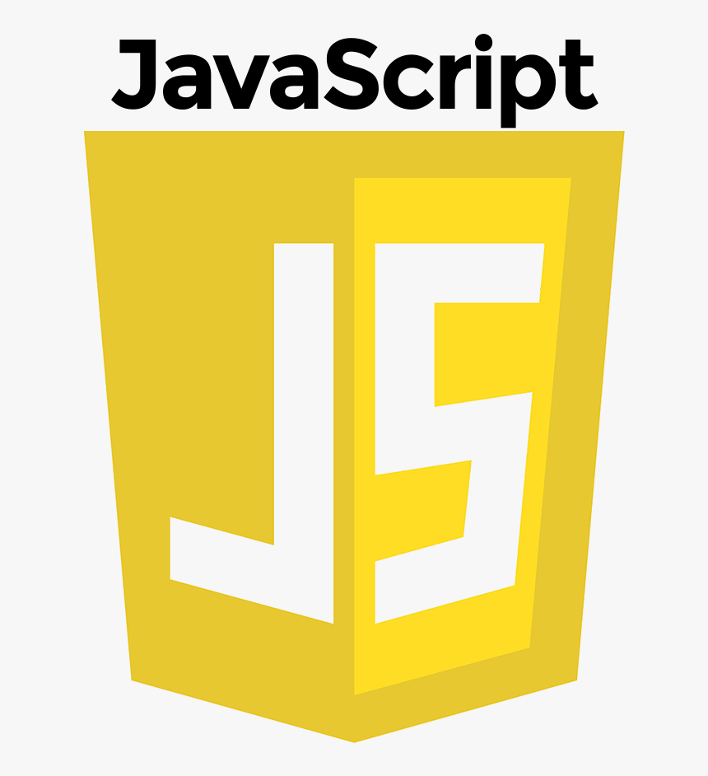



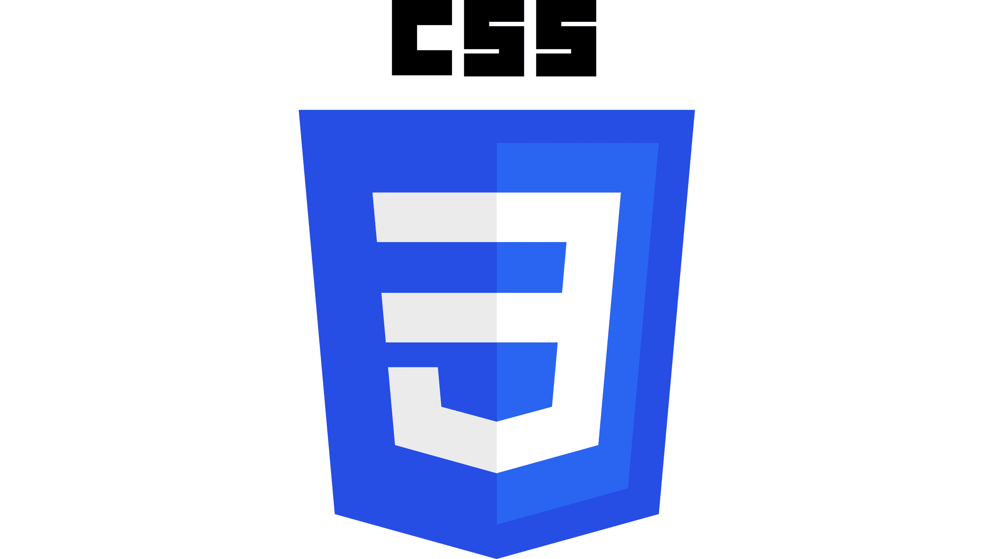


STACKS

Slide 9
Project Objectives:

Slide 10
Project Scope:
HR Technology and analytics
Implementing and managing Human Resource Information System (HRIS)
Utilizing data analytics for performance for workforce
Automating HR Process
Leveraging technology for employee
Ensuring data security and privacy complain

Slide 11
System Architecture

Slide 12
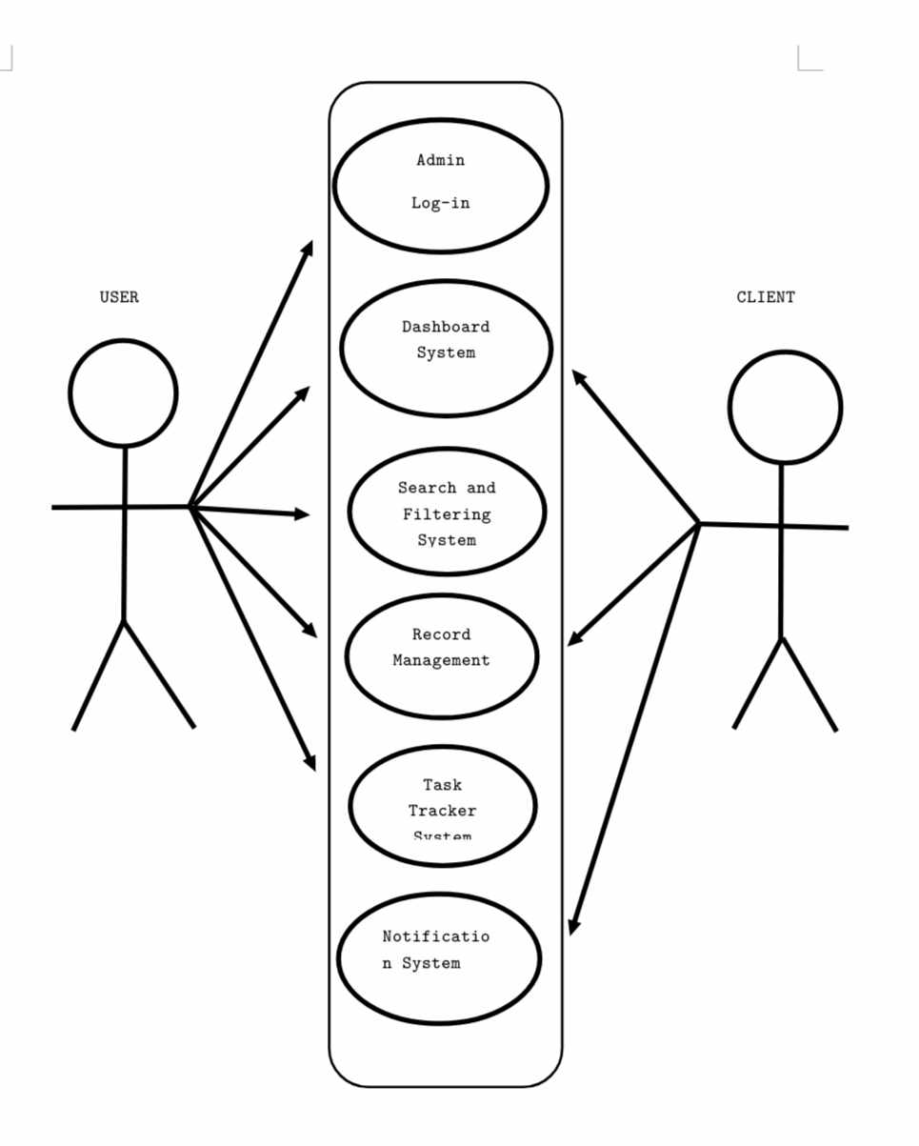
Application Architecture

Slide 13
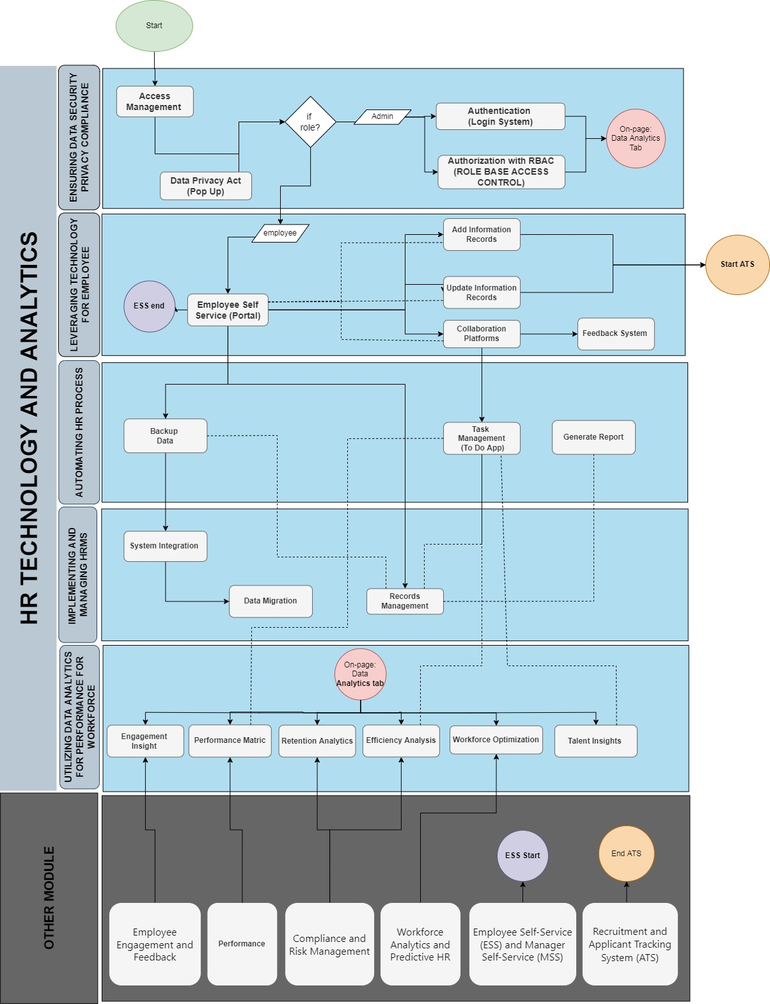
Business Process Architecture

Slide 14
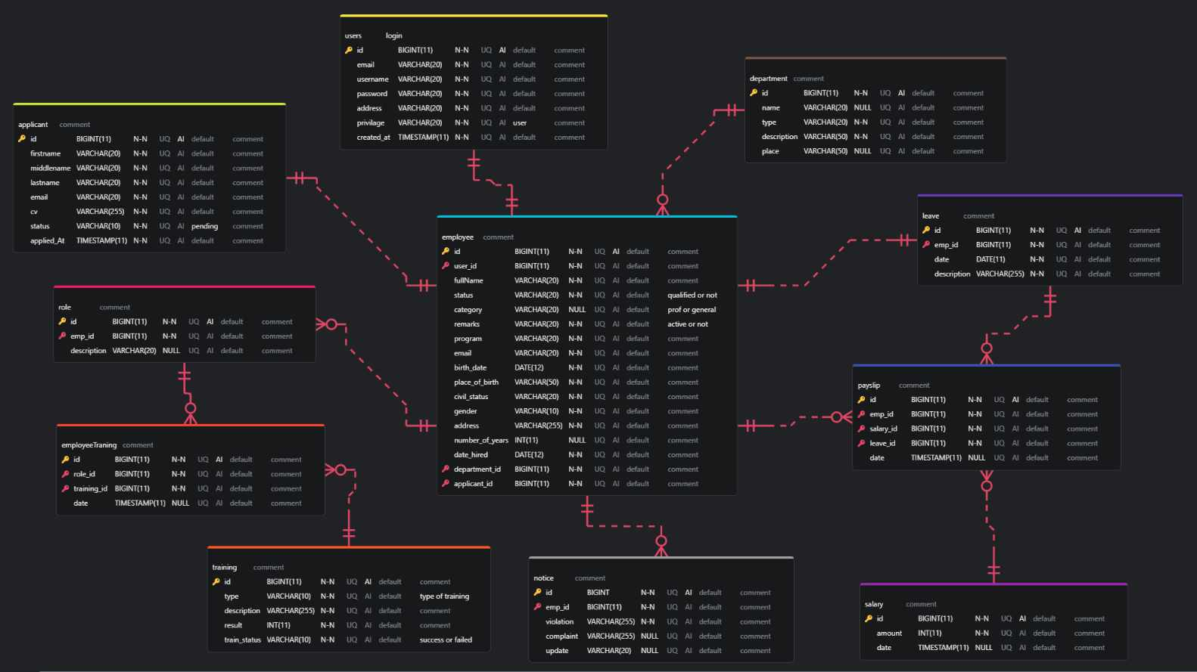
Data Schema Architecture

Slide 15
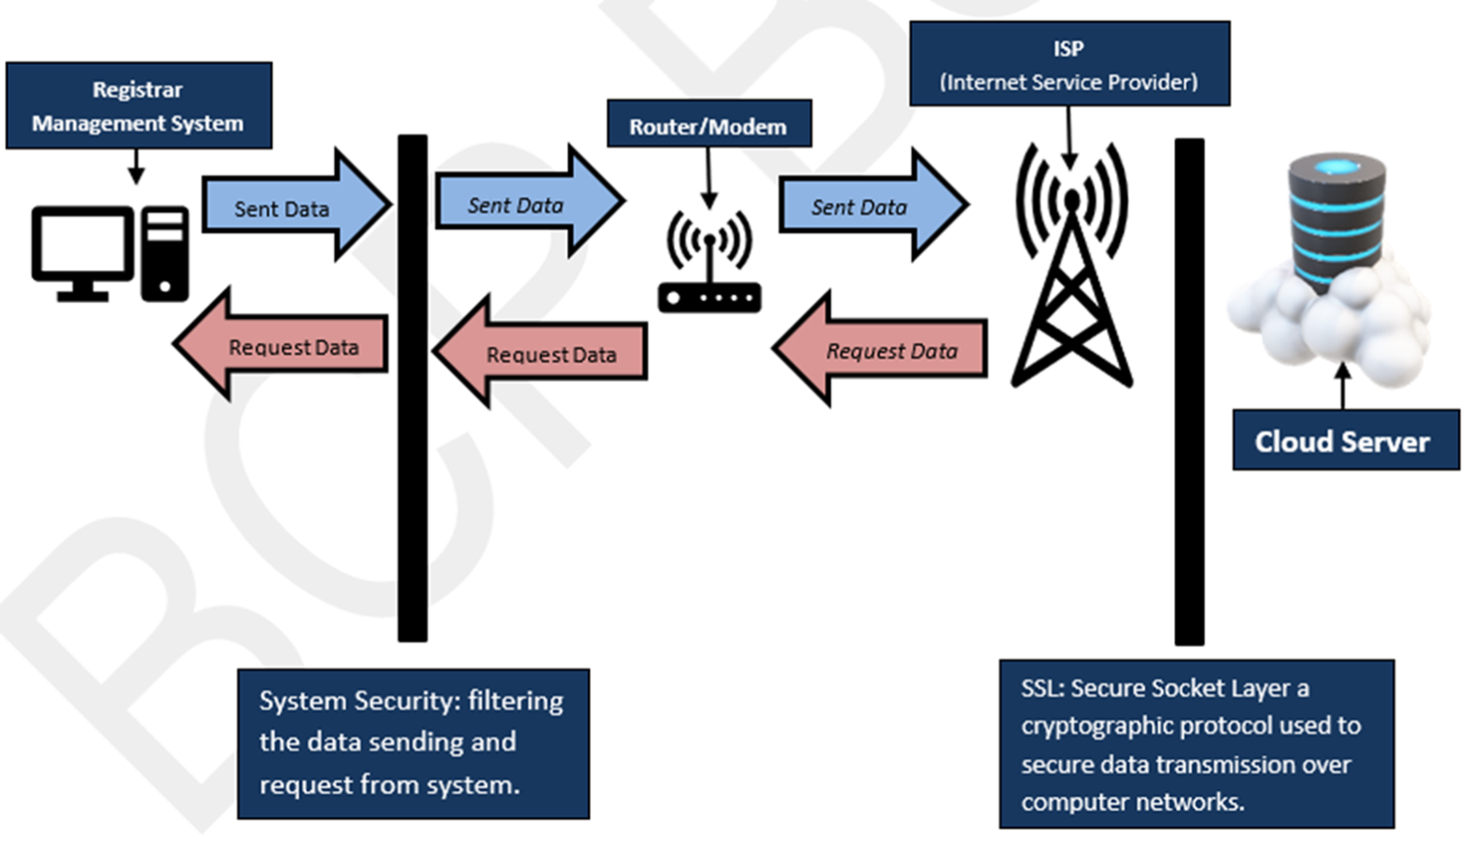
TECHNICAL SOLUTION DESIGN

Slide 16
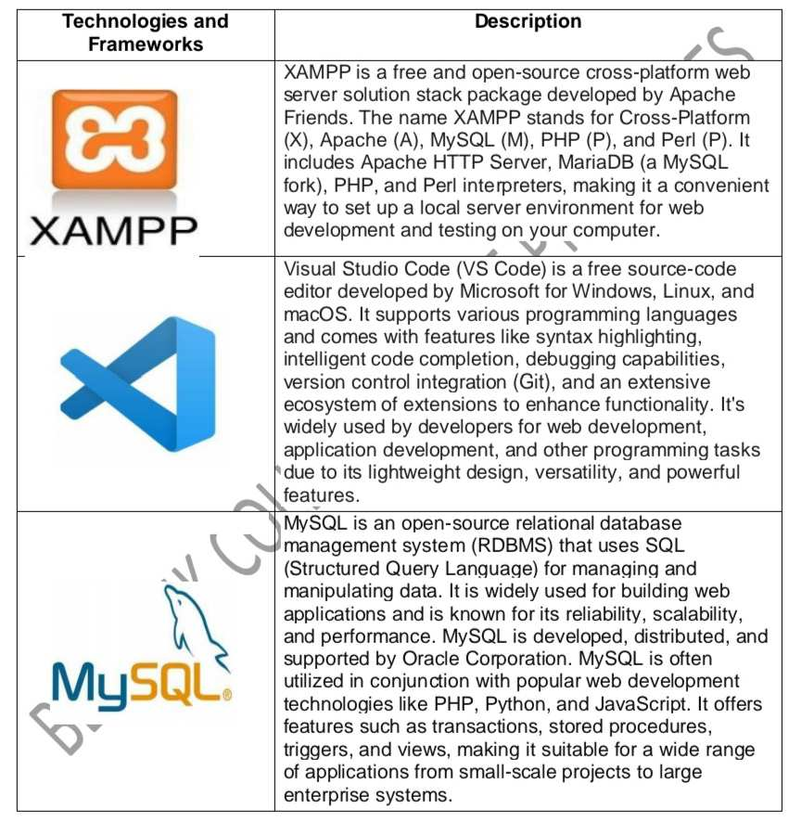
Technology Architecture

Slide 17
SOFTWARE AND HARDWARE SPECIFICATION
SOFTWARE | SPECIFICATION | DESCRIPTION
XAMPP | Cross-platform, includes Apache server and MySQL database, for Windows, Linux, and MacOS. | A local development environment with Apache, MySQL (MariaDB), PHP, and Perl.
MySQL | Uses SQL, supports large, scalable databases, compatible with PHP, Java, and Python. | An open-source database management system for web applications.
VS code | Supports debugging, version control, extensions, and languages like JavaScript, Python, and PHP. | A free code editor by Microsoft for multiple programming languages.

Slide 18
SOFTWARE SPECIFICATION
SOFTWARE | SPECIFICATION | DESCRIPTION
Bootstrap | 12-column grid system, pre-built components, supports SCSS customization. | A front-end framework for building responsive websites.
Firefox | Cross-platform, private browsing, customizable, developer tools for debugging. | A privacy-focused, open-source web browser.
JavaScript | Object-oriented, used in browsers and for server-side with Node.js. | A client-side language for creating interactive web content.

Slide 19
SOFTWARE SPECIFICATION
SOFTWARE | SPECIFICATION | DESCRIPTION
PHP | Open-source, often paired with MySQL, used for generating dynamic pages. | A server-side scripting language for dynamic web development.
HTML | Defines page elements like headers, links, and multimedia. | The standard markup language for web page structure.
CSS | Controls page layout, responsive design, and supports animations. | A stylesheet language for web design and layout.

Slide 20
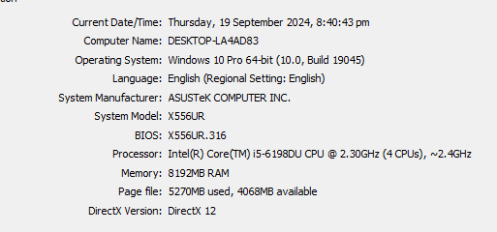
HARDWARE SPECIFICATION

